Slide 1
Data Visualization Project
Teodorescu Andrei
Eugen Mihail
505 BDTS

Slide 2
Introduction
The chosen dataset contains the top 250 most expensive football transfers made between season 2000-2001 until season 2018-2019. The dataset was created on 1 August 2018 and this was uploaded to kaggle.com by a student from Duke University, United States.
Here is the link to the dataset:
https://www.kaggle.com/vardan95ghazaryan/top-250-football-transfers-from-2000-to-2018

Slide 3

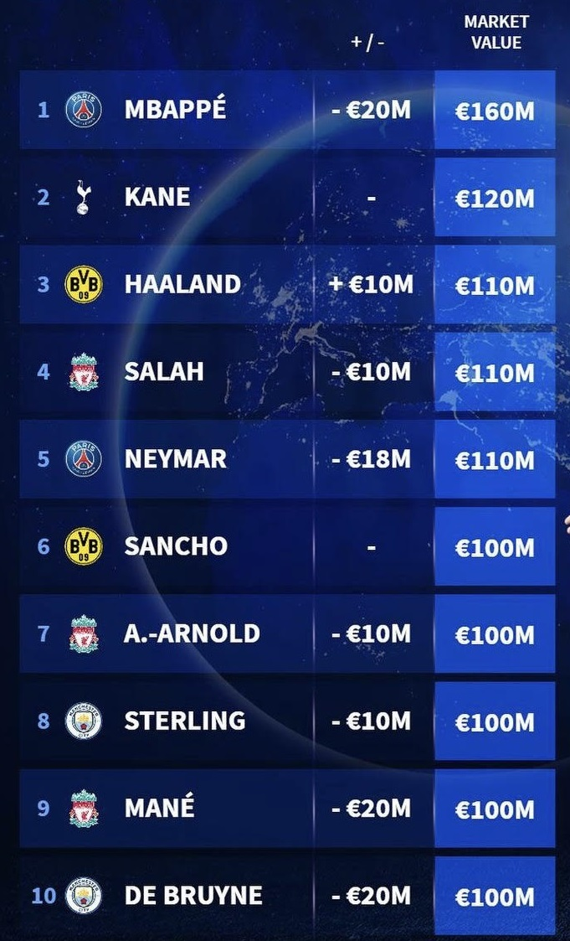
Motivation
We chose this dataset because we are both passionate about this football transfer industry and because at first glance it seemed like a dataset from which we could draw interesting conclusions about this topic.

Slide 4
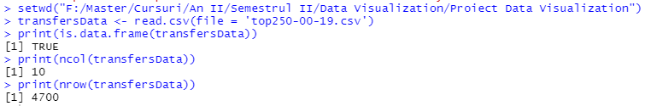
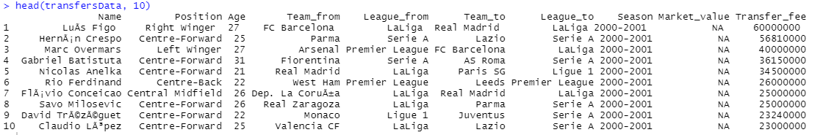
Preparation
We started the project by loading the data set and analyzing it in detail.

Slide 5
Starting point
We started our journey from the most expensive transfer that was made throughout the nine seasons and it was nobody else than Neymar when he left Barcelona for PSG.

Slide 6
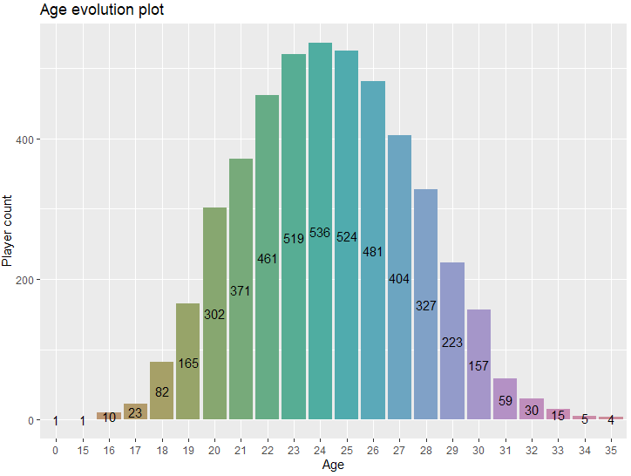
Beginning of interpretation
It can be seen that the age of a player greatly influences the chances of him being included in a transfer. We can consider that the age of 25 is the moment when a player can reach his peak of form. As the player gets older, the chances of him being transferred diminish, because 33 is the age until which most players play at a professional level.

Slide 7
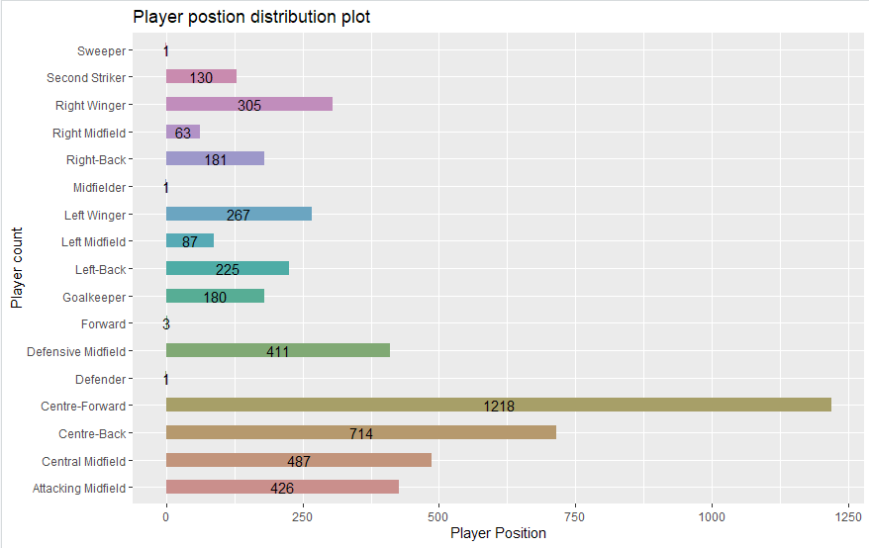
Player position distribution
This plot is very interesting, at first sight we can see that the most sought after players are those who play in central positions: Centre-Forward, Centre-Back, Centre-Midfield and those who position themselves on the flanks have a lower number of transfers.

Slide 8
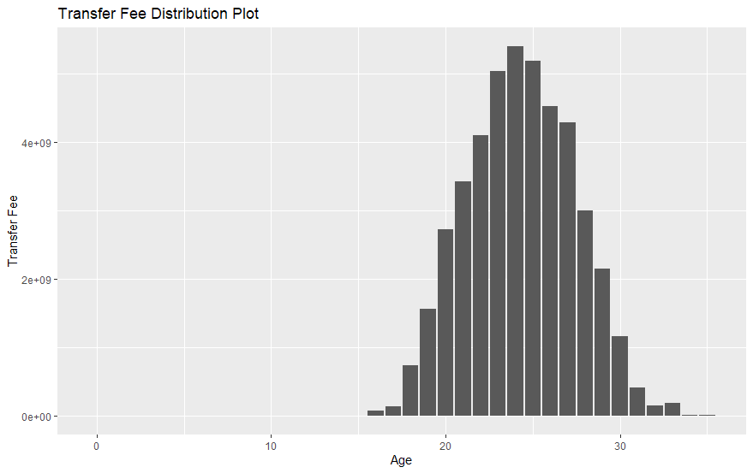
Transfer value distribution
This plot comes somewhat in addition to the one about age distribution. The same conclusion can be drawn, as a player approaches the age of 24-25 his value increases, then begins to gradually decrease.

Slide 9
Plot-uri Eugen

Slide 10
Plot-uri Eugen

Slide 11
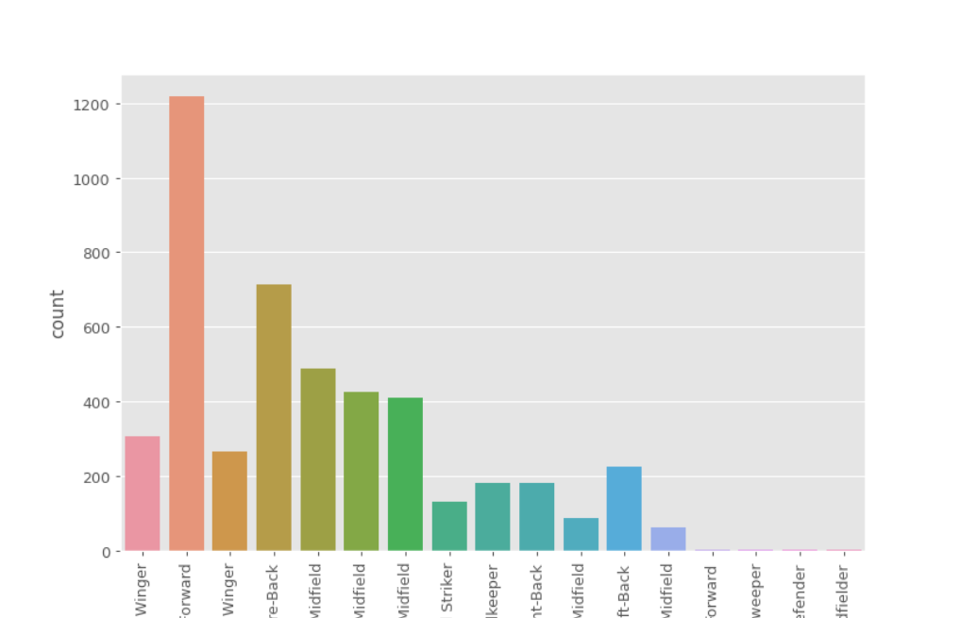
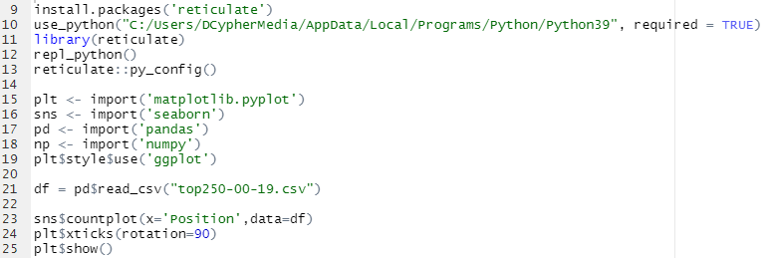
Reticulate library
In developing this project we tried to use the relicate library in R Studio, but we were not very successful. But still these are our results.

Slide 12
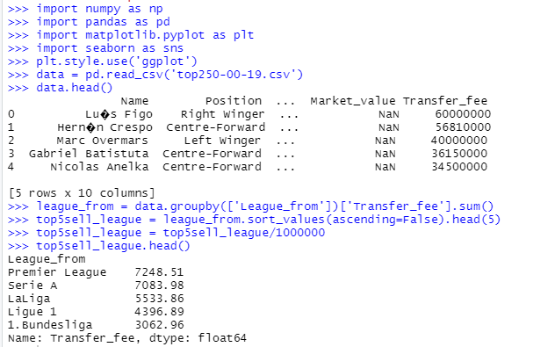
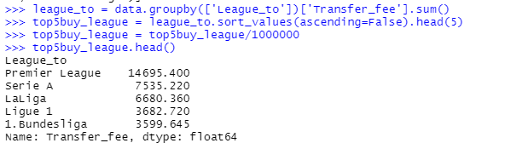
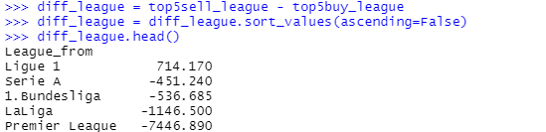
Top 5 of Buying Leagues
Top 5 of Selling Leagues
Top 5 of Profitable Leagues

Slide 13
Conclusion
After the development of this project we can say that we retained basic knowledge in manipulating and visualizing a dataset. At the same time, we would have liked to succeed more in the part where we tried to use the Relicate library.

Slide 14
Thank you for your attention!
Have a great day!

